Slide 1
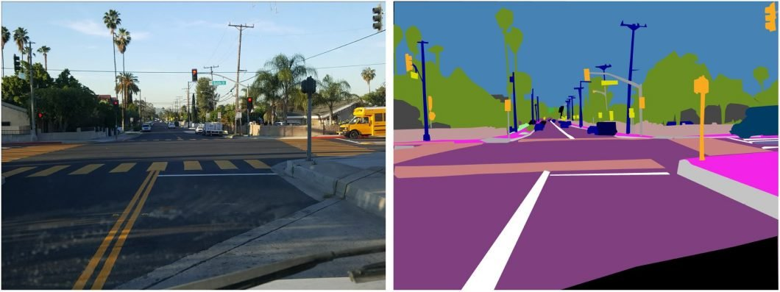
Object Segmentation
Source: VISO.AI

Slide 2
Contents:
Introduction of Object Segmentation
Use cases of Object Segmentation
How object segmentation different from object detection and classification
Algorithms of object segmentation
YOLOv7 Model
Object Segmentation with YOLOv7
Evaluation Metrics

Slide 3
Introduction to Object Segmentation
It is a technique that involves identifying and separating objects within an image or video
The goal of object segmentation is to accurately locate and isolate the foreground objects from the background
It works by identifying the boundaries of the foreground objects
It also assigns labels to every pixel in an image
The pixels with the same label share certain characteristics

Slide 4
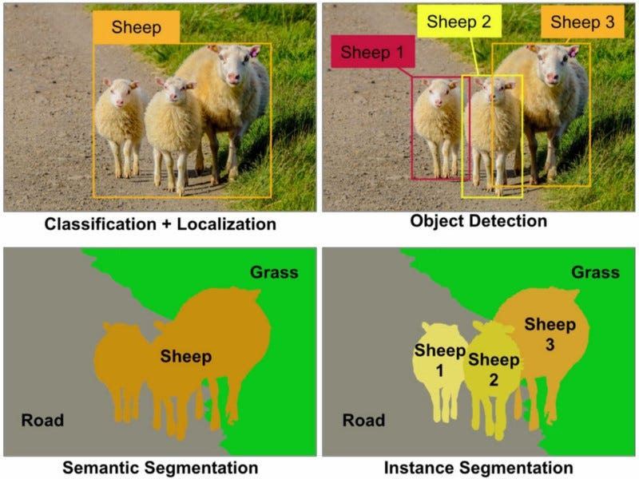
Source: MEDIUM.COM

Slide 5
Use cases of Object Segmentation
Autonomous Driving
Augmented Reality
Medical Imaging
Video Surveillance
Robotics
Sports Analytics

Slide 6
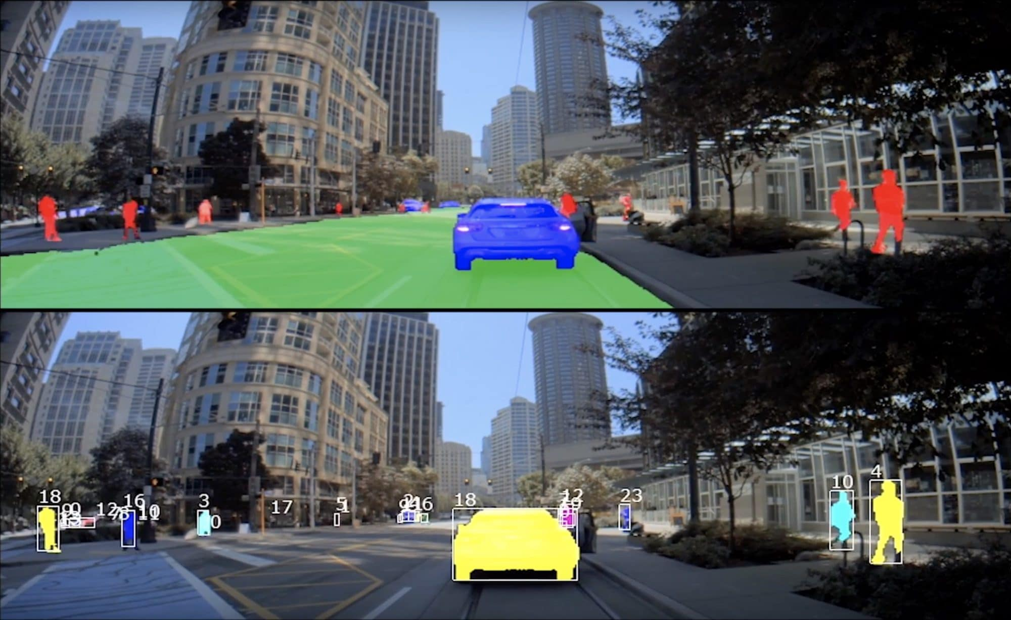
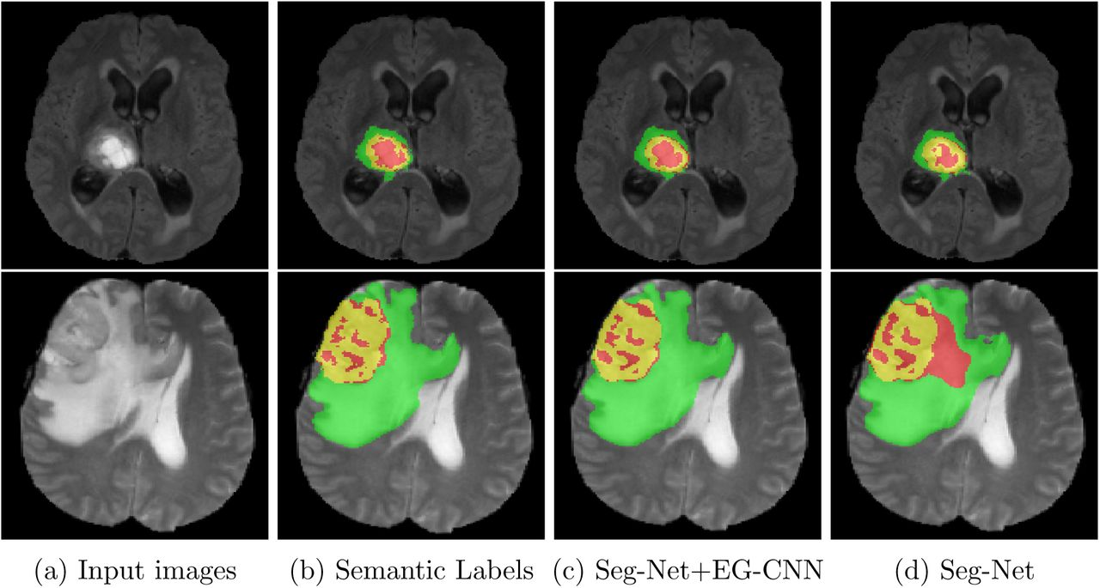
Source: NVIDIA
Source: Cold Spring Harbour Laboratory

Slide 7
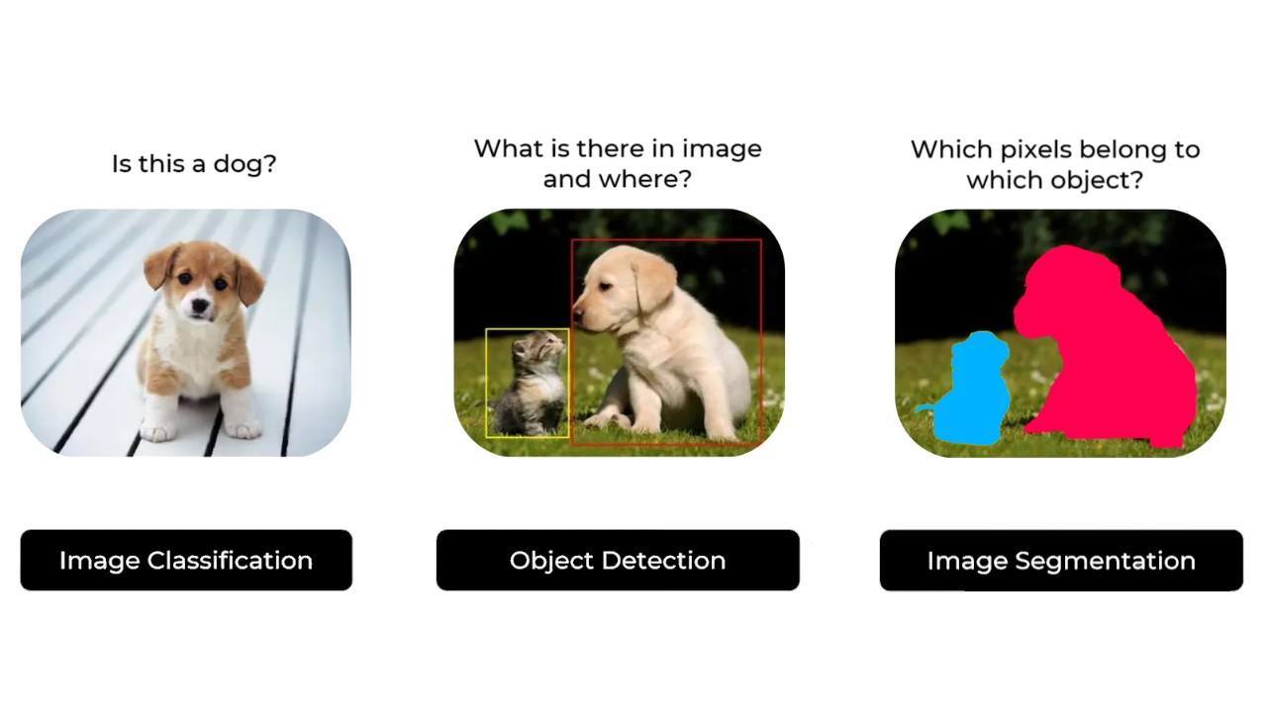
Segmentation vs Object detection and Classification
Source: LINKEDIN

Slide 8
Algorithms for Object Segmentation
Watershed
U-NET
YOLO
GrabCut
FCN
MASK RCNN

Slide 9
Yolov7 Model
This version of YOLO uses a single neural network to detect and localise objects.
It can perform the following tasks:
Object Detection
Object Classification
Object Segmentation(Instance Segmentation)
Fast and accurate algorithm which can be used for real time object detection, classification and segmentation.

Slide 10
Steps to perform Object Segmentation
Step 1: Git clone YOLOv7 model with the link given below: https://github.com/WongKinYiu/yolov7.git
Step 2: Prepare the dataset for custom training
Step 3: Annotate the dataset with the custom class
Step 4: Train YOLOv7 model on seg.pt weights
Step 5: Test the model by using the best.pt weights of the trained data
Step 6: Use an Evaluation Metric to check the performance

Slide 11
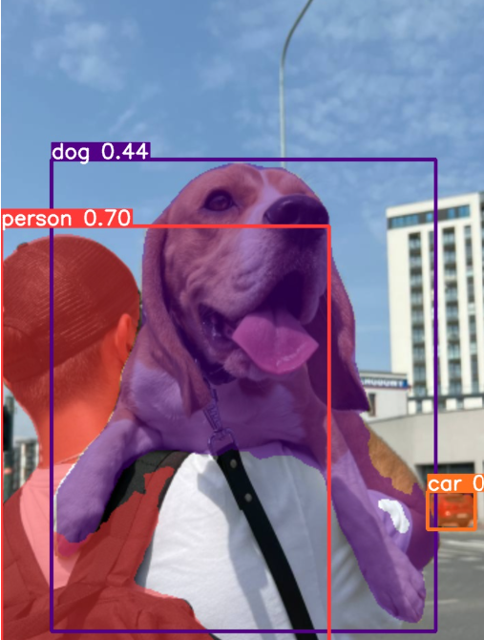
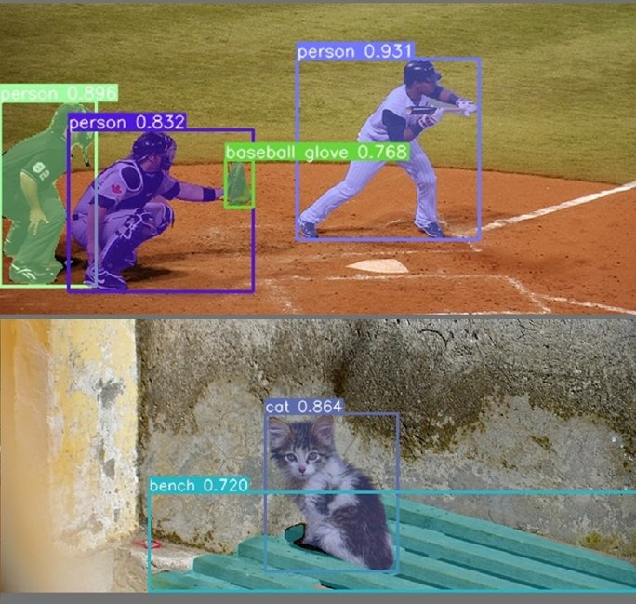
Results:
Source: VISO.AI

Slide 12
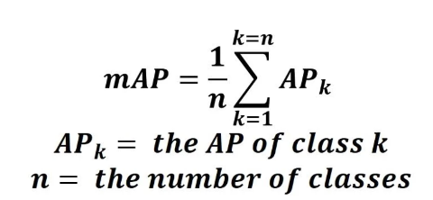
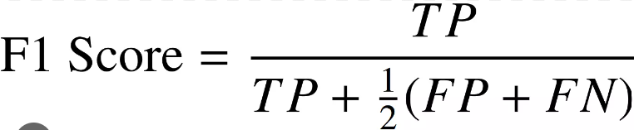
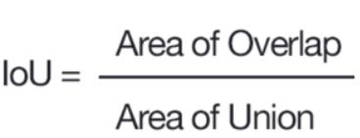
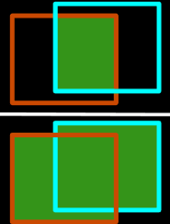
Evaluation metrics
Source: TOWARDSDATASCIENCE.COM

Slide 13
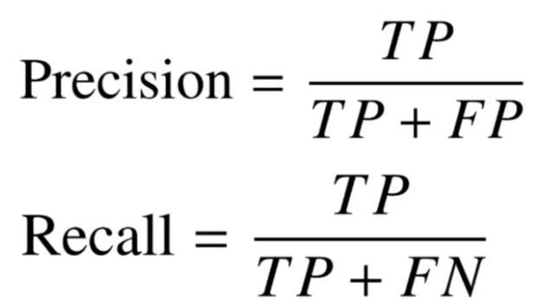
Evaluation metrics (contd..)
Pixel Accuracy = No. of correct pixels/No. of all pixels

